Slide 5
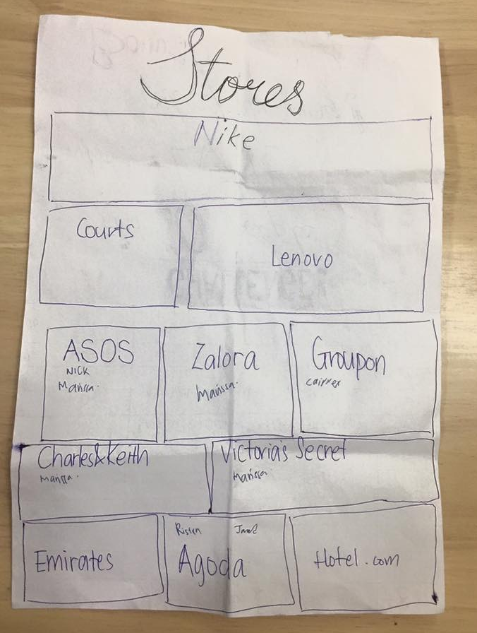

Slide 6
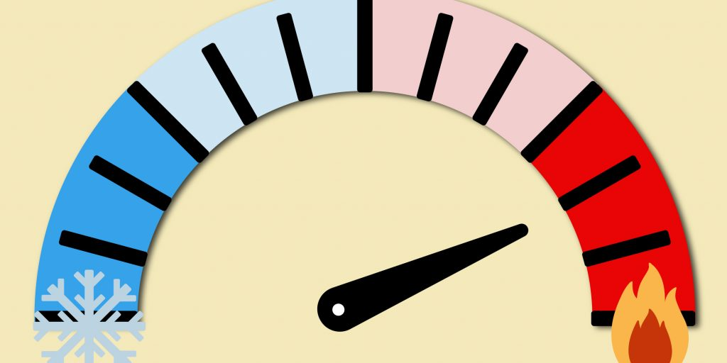
Warm Market
versus
Cold Market

Slide 7
Warm Market

Slide 10
Networking

